Slide 1
Identity Management
Sprint 5
Jacob Gianakopoulos, Steven Scott, Samuel Vitale, Alex Bowen, Andy Jolagh, Nick Attisha

Slide 2

Sprint 5 Preview
Server integration
Backend Refinement
Recognition Progression

Slide 3
Sprint 5 Tasks:
Facial Detection
Use opencv to create a python script to detect facial features in a given photo
Server Integration
Troubleshoot server connectivity
Get the team working with a single database
App Improvements
Finish integrating facial detection
Improve server and app code

Slide 4
Backend Progress
Added more security checks to server code
Added updated UI to the project
Cleaned up app code
Fixed face upload code

Slide 5
Server Setbacks
A lot of time was spent troubleshooting server connectivity, because the scripts failed with no error messages.
Created new scripts that only tested database connection from php.
Investigated network connectivity, set up multiple types of server and database logs
Reinstalled all software, and configured services on a separate VM
Discovered that the php functions that we were using to connect to mysql were not default php.

Slide 6
Server - Current State
All the connectivity problems have been resolved.
All team members can now use the live database, access the same data, and run scripts from the application or a browser to be executed on the server.

Slide 7
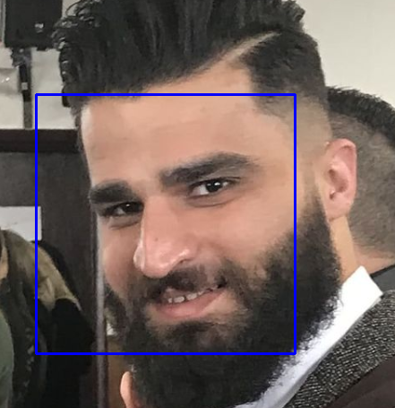
Facial Recognition Progress
Using scikit-learn libraries implementation of SVM’s for machine learning model.
Currently working on extracting the 128-D face embeddings to input into the SVM.

Slide 8
Demo

Slide 9
Future User Stories
As a user, i want to sign in to 3rd party websites without a password.
As a user, i want to sign in to a 3rd party website with safety.
As a developer, i want a testing/demo environment for oauth2.

Slide 10

Major Tasks Going Forward
1
2
Implement Facial recognition features
Distinguish between faces instead of just detecting
Create secondary login script to login if the face matches what is on file
Secure the environment for the User
Design third party sign-in view.
Create an environment the user will be safe to use and store they information.
Create test environment - mock third party site

